Slide 1
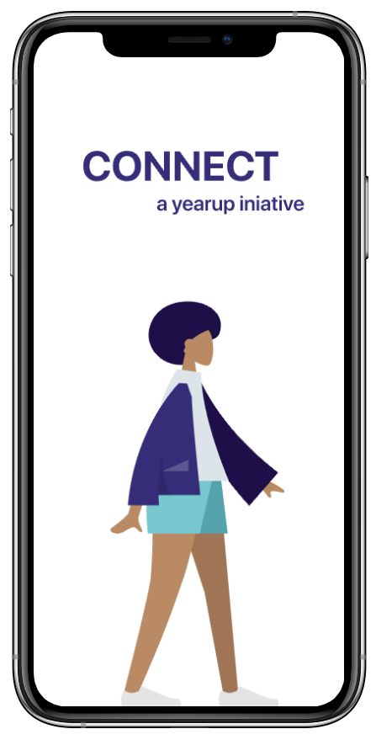
YearUp Connect
Humanizing Mentorship

Slide 2
The Problem

Slide 3
60,000
Young People Disconnected

Slide 4

By Hand
Year Up Approach
Inefficient matching, missing feedback, and limited scalability.

Slide 5
Our Approach

Slide 6

The User
Mentee, Mentor, Administrator.

Slide 7
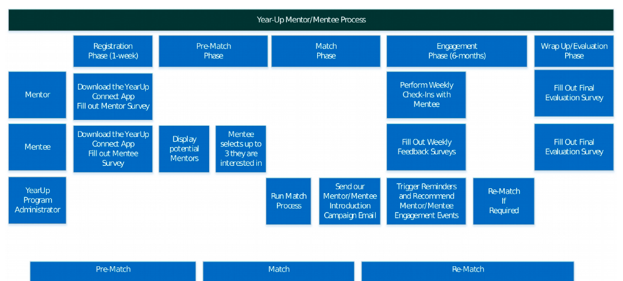
The Thought Process

Slide 8
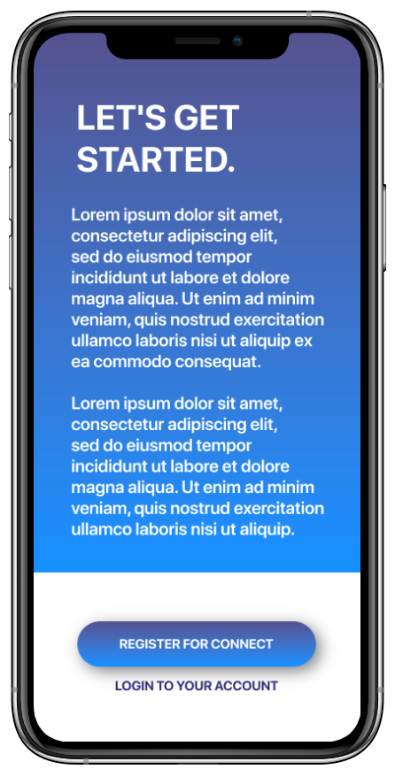
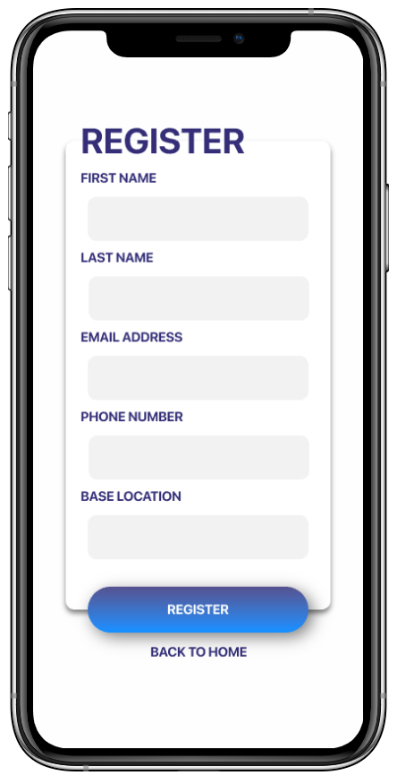
Welcome Page
Getting Started
Register Page

Slide 9
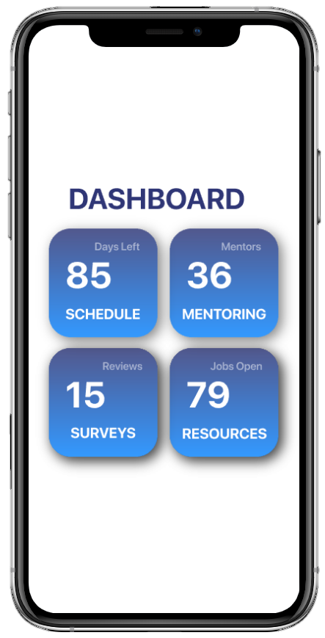
Meeting Scheduling with Staff and Mentor
Pre-Matches/ Mentor Hub
Weekly Surveys for Engagement
Online YearUp Resources

Slide 10
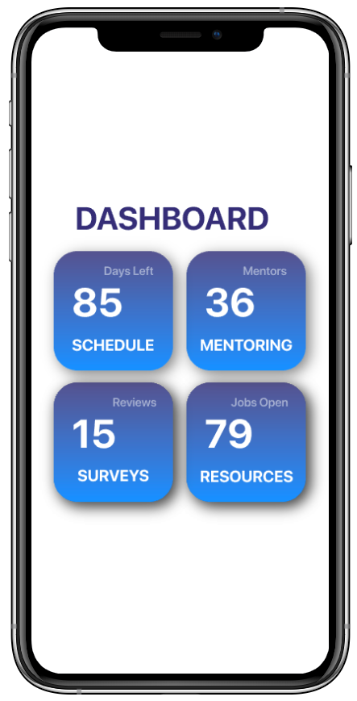
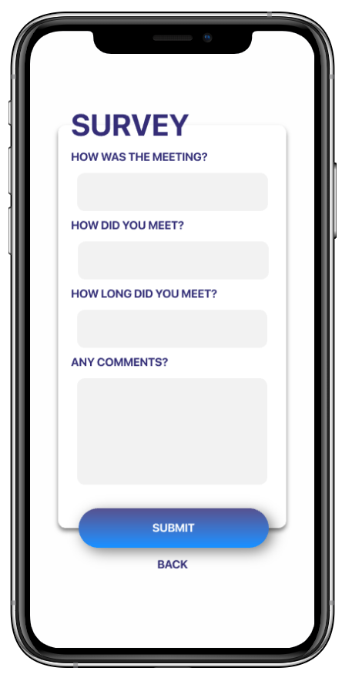
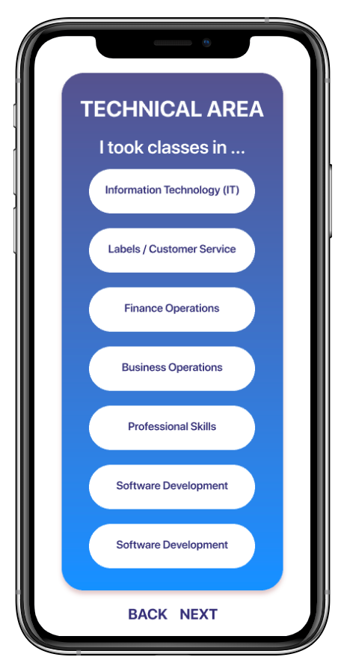
Main Dashboard
Weekly Surveys
Pre-Matching

Slide 11
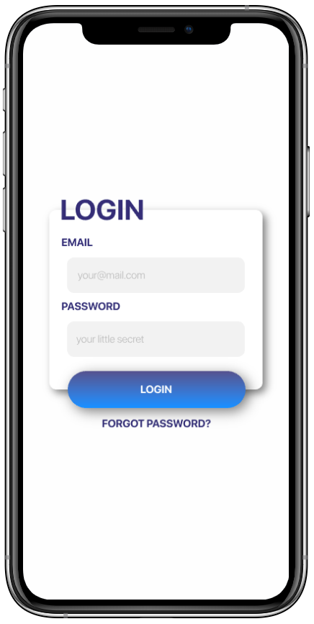
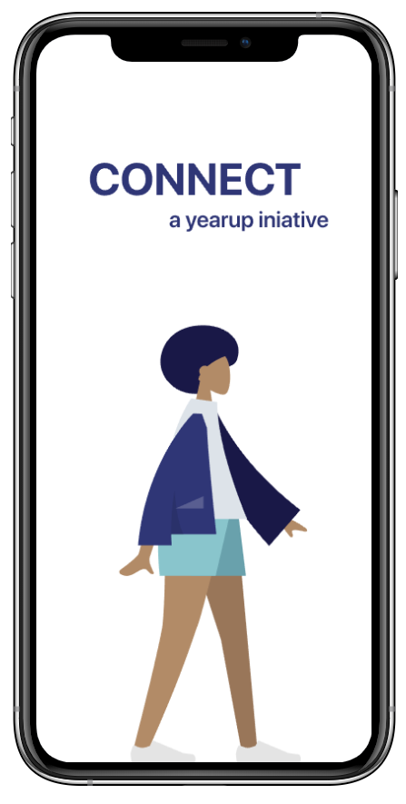
Benefits of yuConnect
Easy to access for all users
Optimizes and automates the matching process
Promotes engagement through bi-weekly surveys
Allows early intervention through data analytics

